Slide 1
Closure properties of regular languages
Dr G Sudha Sadasivam

Slide 2
Introduction
Regular languages are closed under union, intersection, concat, complement, reversal, Kleene closure, positive closure, Difference and homomorphism.
Closure properties on regular languages are defined as certain operations on regular language which are guaranteed to produce regular language

Slide 3
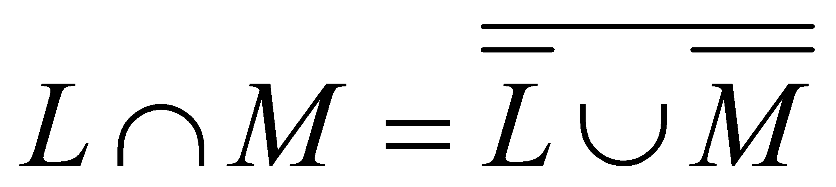
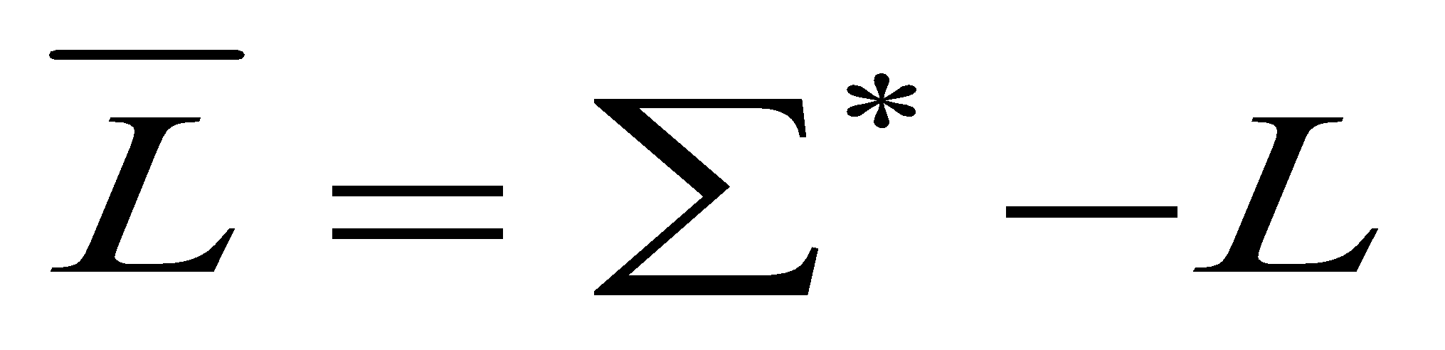
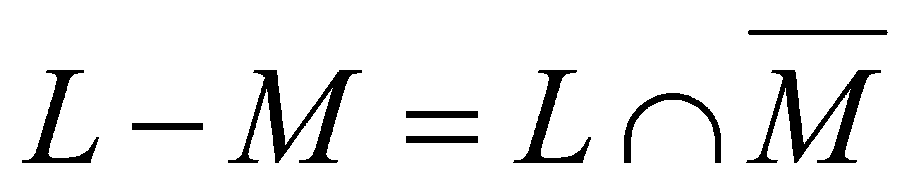
Let L and M be regular languages for regular expr R & S:
Kleen Closure: R* is a regular expression whose language is L*.
Positive closure: R ⁺ is a regular expression whose language is L ⁺.
Union : L UM is closed and is given by RE R + S
Intersection:
Using Demorgan’s laws
Union and complement operations are closed for Regular languages
Concatenation: RS is a regular expression whose language is LM.
Complementation: If L is regular language, so is
Difference is closed:

Slide 4
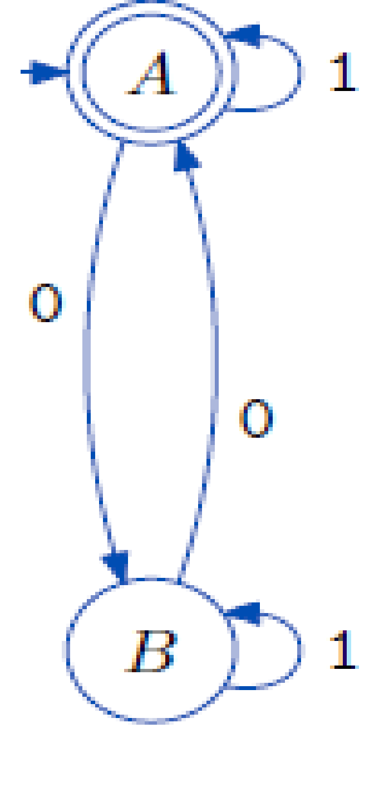
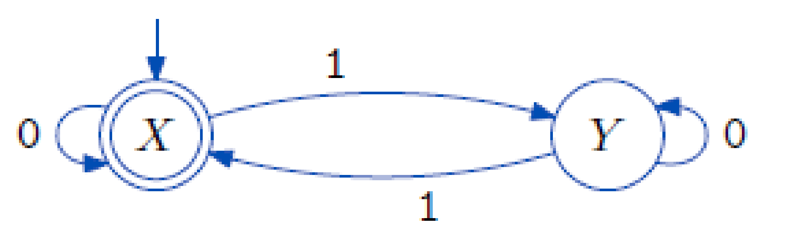
Example- L: Even no of zeros, M – even no of ones
L | 0 | 1
A* | B | A
B | A | B
M | 0 | 1
X* | X | Y
Y | Y | X

Slide 5
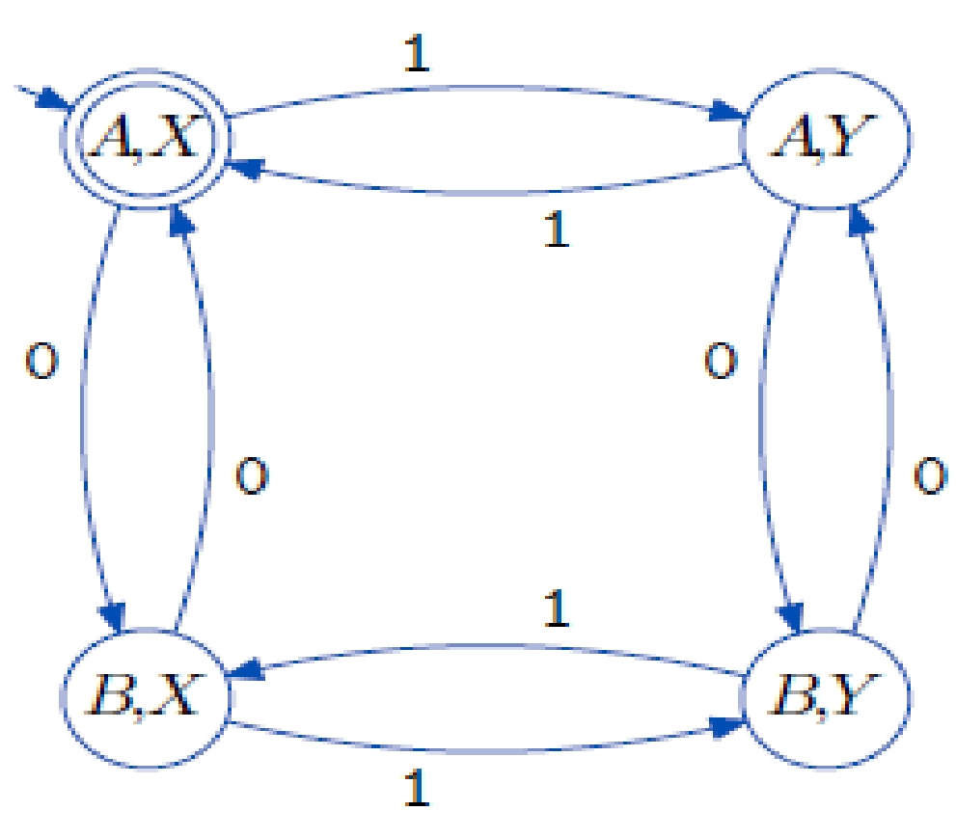
Union
L={Q1,Σ,q1,F1,δ1}; M= {Q2,Σ,q2,F2,δ2}
L U M = { Q1 x Q2, Σ,(q1,q2), F1 U F2, δ }
δ ((r,s),x)= (δ1 (r,x), δ2 (s,x))
L | 0 | 1
A* | B | A
B | A | B
M | 0 | 1
X* | X | Y
Y | Y | X
L U M | 0 | 1
AX* | BX | AY
AY* | BY | AX
BX* | AX | BY
BY | AY | BX

Slide 6
Intersection
L={Q1,Σ,q1,F1,δ1}; M= {Q2,Σ,q2,F2,δ2}
L Ⴖ M = { Q1 x Q2, Σ,(q1,q2), F1 Ⴖ F2, δ }
δ ((r,s),x)= (δ1 (r,x), δ2 (s,x))
L | 0 | 1
A* | B | A
B | A | B
M | 0 | 1
X* | X | Y
Y | Y | X
L U M | 0 | 1
AX* | BX | AY
AY* | BY | AX
BX* | AX | BY
BY | AY | BX

Slide 7
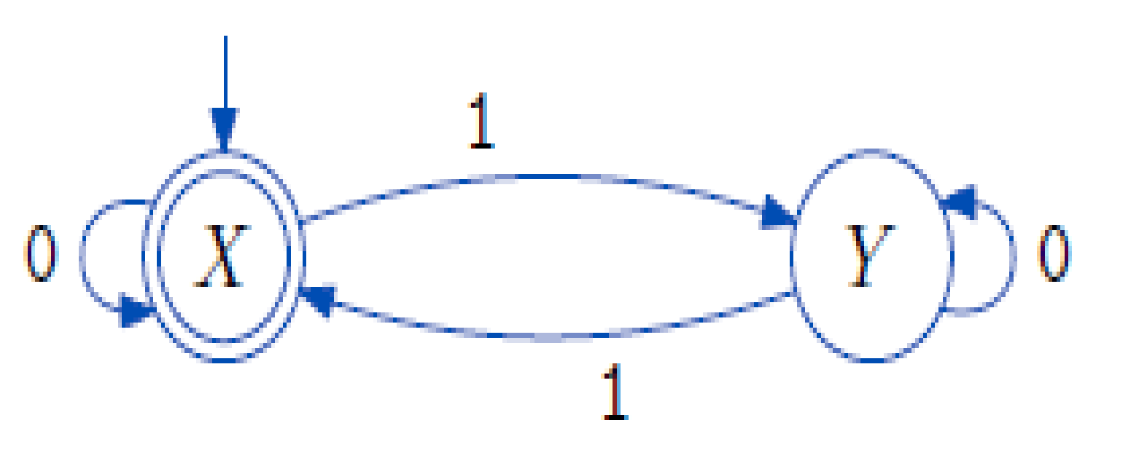
Complement
Interchange acc and non-acc states
Accept even number of 1’s : M
Complement is : odd number of 1’s
1
X
Y
0
1
0

Slide 8
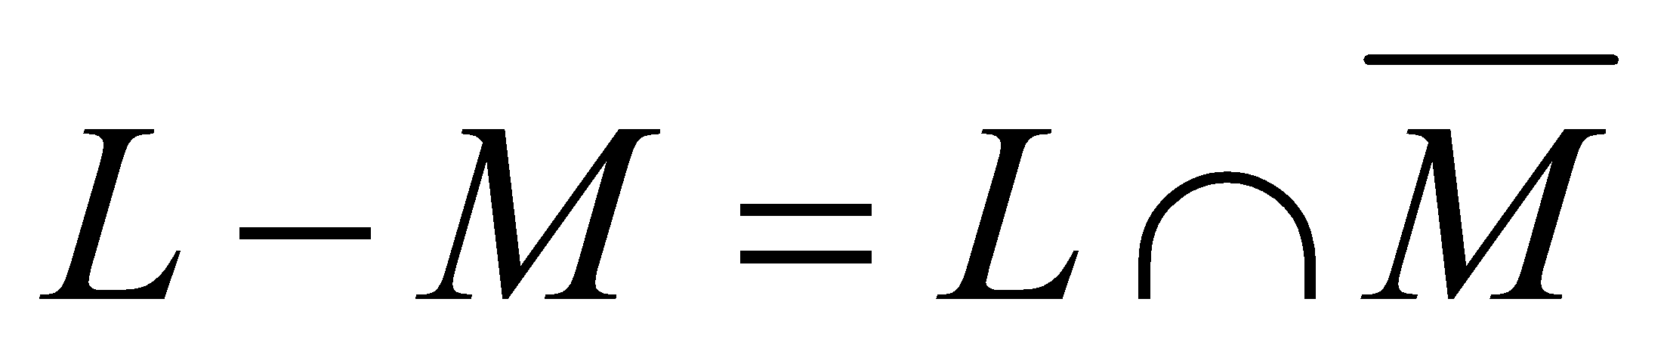
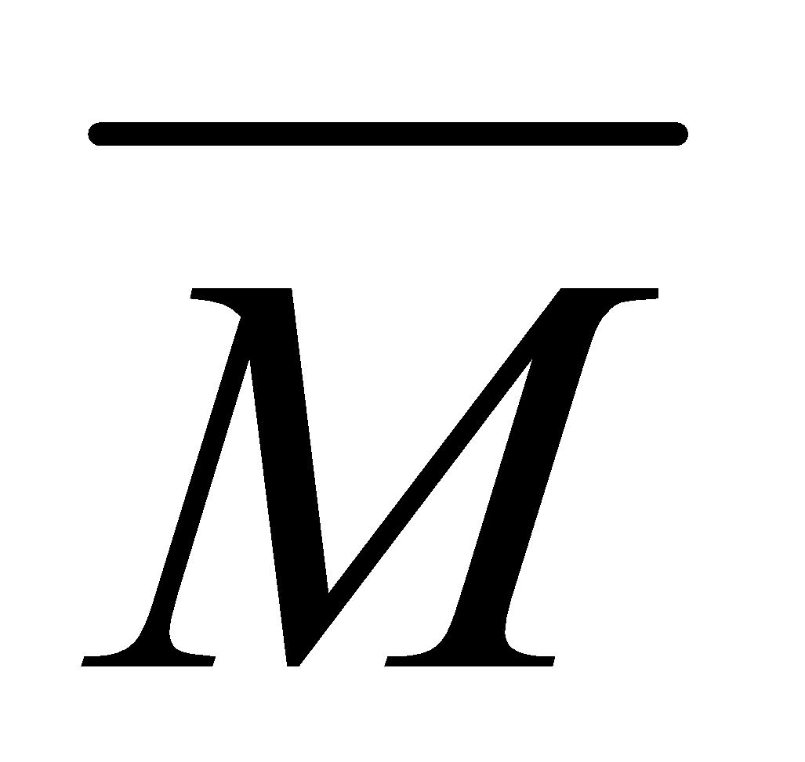

Difference
1
X
Y
0
1
0
L | 0 | 1
A* | B | A
B | A | B
 | 0 | 1
X | X | Y
Y* | Y | X
 | 0 | 1
AX | BX | AY
AY* | BY | AX
BX | AX | BY
BY | AY | BX

Slide 9
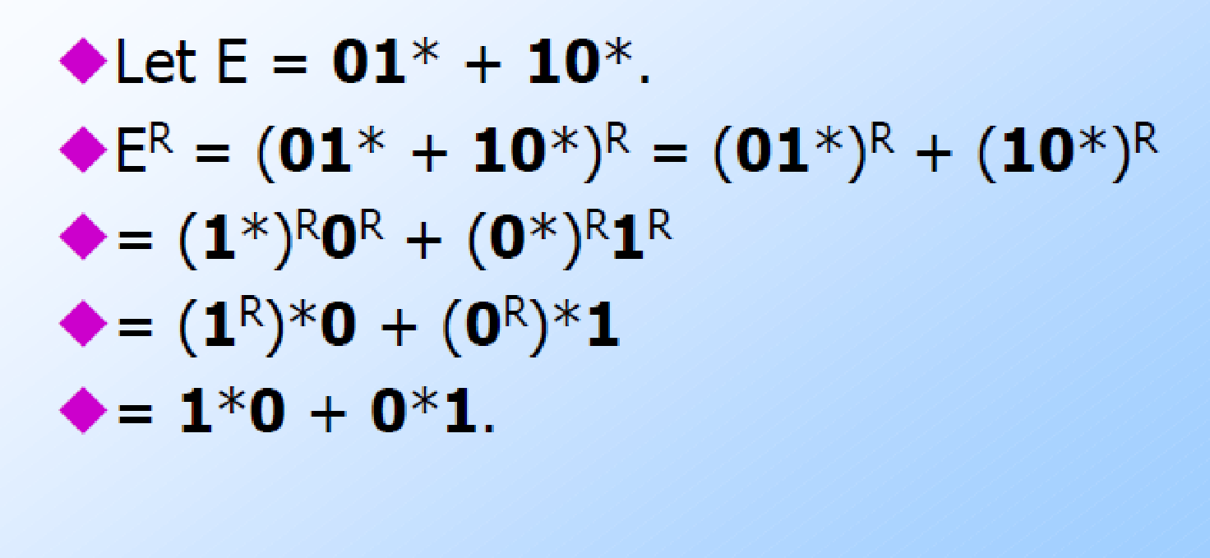
Reversal
Given language L, L^{R} is the set of strings whose reversal is in L.
Example: L = {0, 01, 100}; L^{R} = {0, 10, 001}.
Basis: If E is a symbol a, ε, or Ⴔ, then E^{R} = E.
Induction: If E is RE is given by
F+G, then E^{R} = F^{R} + G^{R}.
FG, then E^{R} = G^{R}F^{R}
F*, then E^{R} = (F^{R})*.

Slide 10
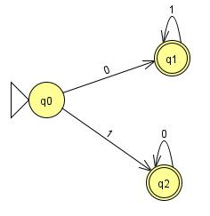
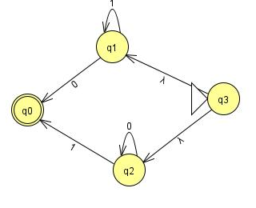
L
L^{R}
If multiple accept state make a new accept state with ε transition.
Make start as acc state and accept state as non acc start state

Slide 11
Homomorphism
A homomorphism on an alphabet is a function that gives a string for each symbol in that alphabet.
Example: h(0) = ab; h(1) = ε.
So h(01010) = ababab
If L is a regular language, and h is a homomorphism on its alphabet, then h(L) = {h(w) | w is in L} is also a regular language.
Proof: Let E be a regular expression for L.
Apply h to each symbol in E.
Language of resulting RE is h(L).
Eg: 01* →(ab) ε*→ ab

Slide 12
Ex2: Let h(0) = ab; h(1) = ε.
Let L be the language of regular expression 01* + 10*.
Then h(L) is the language of regular expression
abε* + ε(ab)*.
→ ab + (ab)*
→ (ab)* as ab is contained in (ab)*

Slide 13
Inverse Homomorphism
Let h be a homomorphism and L a language whose alphabet is the output language of h.
h⁻¹(L) = {w | h(w) is in L}.
Let h(0) = ab; h(1) = ε.
Let L = {abab}.
h⁻¹(L) = the language with two 0’s and any number of 1’s = L(1*01*01*).

Slide 14
Example: Inverse Homomorphism Construction
a
1
Since
h(1) = ε
B
B
1
a
A
b
A
0
b
b
0
Since
h(0) = ab
C
C
a
1
, 0
h(0) = ab
h(1) = ε

Slide 15
Proof – (3)
Induction on |w| shows that δ_{B}(q₀, w) = δ_{A}(q₀, h(w)).
Basis: w = ε.
δ_{B}(q₀, ε) = q₀, and δ_{A}(q₀, h(ε)) = δ_{A}(q₀, ε) = q₀.
Induction: Let w = xa; assume inverse homomorphic for x.
δ_{B}(q₀, w) = δ_{B}(δ_{B}(q₀, x), a).
= δ_{B}(δ_{A}(q₀, h(x)), a) by the IH.
= δ_{A}(δ_{A}(q₀, h(x)), h(a)) by definition of the DFA B.
= δ_{A}(q₀, h(x)h(a)) by definition of the extended delta.
= δ_{A}(q₀, h(w)) by def. of homomorphism

Slide 16
Statement of the Pumping Lemma
Not a regular language
Number of
states of
DFA for L
For every regular language L
There is an integer n, such that
For every string w in L of length > n
We can write w = xyz such that:
|xy| < n.
|y| > 0.
For all i > 0, xy^{i}z is in L.
Labels along
first cycle on
path labeled w

Slide 17
Example: Use of Pumping Lemma
We have claimed {0^{k}1^{k} | k > 1} is not a regular language.
Suppose it were. Then there would be an associated n for the pumping lemma.
Let w = 0^{n}1^{n}. We can write w = xyz, where x and y consist of 0’s, and y ≠ ε.
But then xyyz would be in L, and this string has more 0’s than 1’s.

Slide 18
0^{n} 1^{n-k}1^{k} = 0^{n} 1^{n}
Results in more or less no of 1’s than 0’s
So it does not result in language 0^{n} 1^{n}
Not regular
Add / del 1

Slide 19
Ex 2 – PT (ab)^{2n} is not regular
w = xyz
x as (ab)² ; y as (ab)^{2n-2} z is ɛ
such that:
|xy| < n.
|y| > 0.
For all i > 0, xy^{i}z is in L
Now insert i=1 now y is (ab)^{2n-2+1} = (ab)^{2n-1} ; w= (ab)² (ab)^{2n-1} = (ab)^{2n+1} it does not belong to the language

Slide 20
Exercises
Given two regular expressions, find union, intersection, complement (of S) , reversal (of R), difference ( R-S)
closure, concat
R : (0+1)* S: (01)*

